Slide 1
Nikki Bailey-Lundahl
Nevada Mining Association

Slide 2
What is the NVMA?
The Nevada Mining Association’s mission is to unite, educate, advocate, and serve as the public voice of Nevada’s modern mining industry

Slide 3
What is the NVMA?
500+ Member Companies representing
every part of the mining supply chain:
Operators
Exploration
Suppliers
Individuals

Slide 4
Modern Mining in Nevada
9.5% of all U.S. non-fuel mineral production comes from Nevada
The state produces 20 essential minerals critical to our daily lives
15 of Nevada’s 17 counties have an active mine operation
The mining supply chain has a presence in
all 17 counties
Nevada mines operate on only 0.3 percent of Nevada’s 71,000,000 acres

Slide 5
Nevada GDP By Industry
Mining is Nevada’s 12th
Largest Industry
Notes:
People who know that mining exist believe that mining is Nevada’s second largest industry, that is simply not true.

Slide 6
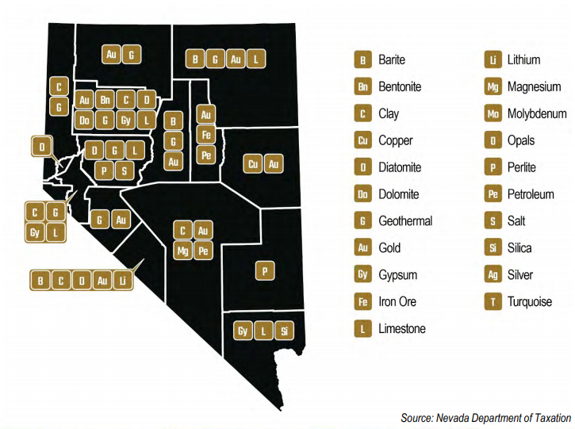
Home to 20 Essential Minerals

Slide 7
Careers,
Not Jobs
37,000 Direct & Indirect Careers
Average Direct Salary: $90,000+
Notes:
People who know that mining exist believe that mining is Nevada’s second largest industry, that is simply not true.

Slide 8
Mining and Natural Resources Industry Employment as a Percentage of Total Employment By County, Average Annual, 2019
Source: Applied Analysis

Slide 9
Workforce Development Efforts
2021 Efforts
Expanding Awareness of careers
Partnership building in Southern Nevada
Project 354 and Nevada Careers pilot program
Notes:
People who know that mining exist believe that mining is Nevada’s second largest industry, that is simply not true.

Slide 10
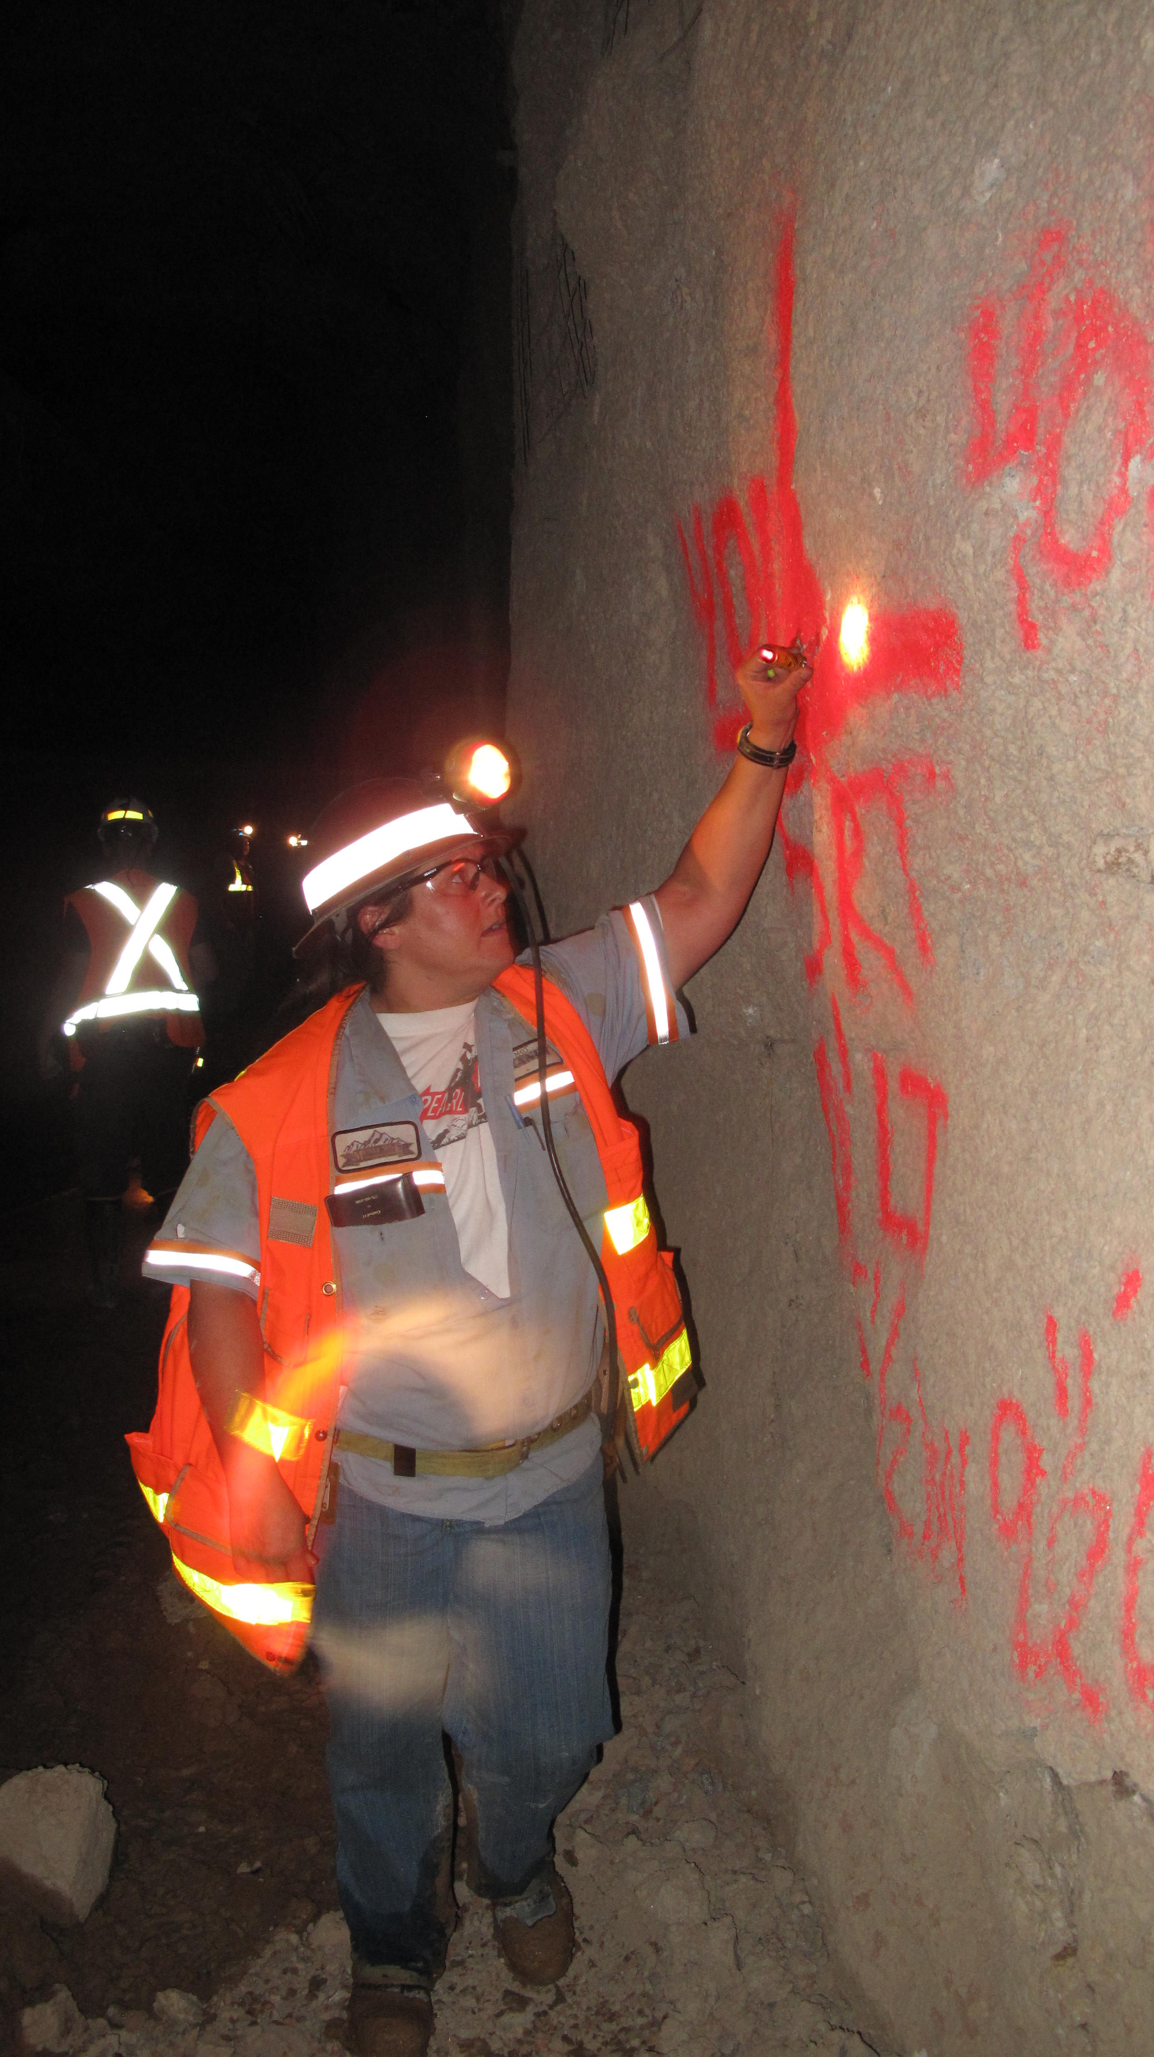
Opportunities for Everyone
Regardless of Education Level….
High School Graduates
Associates
Vocational/ Technical Certifications
Bachelors
Masters
PhDs

Slide 11
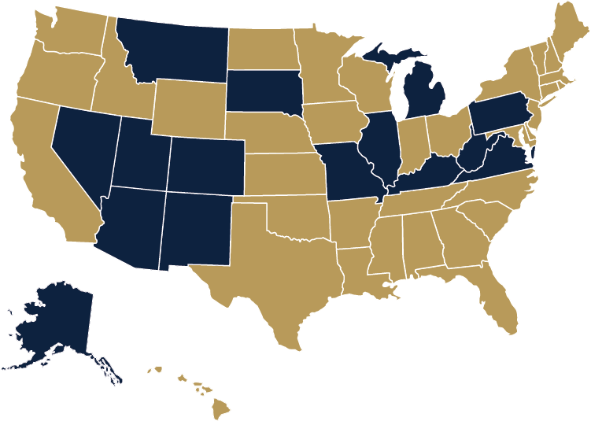
Mining Schools in the United States
Source: Applied Analysis

Slide 12
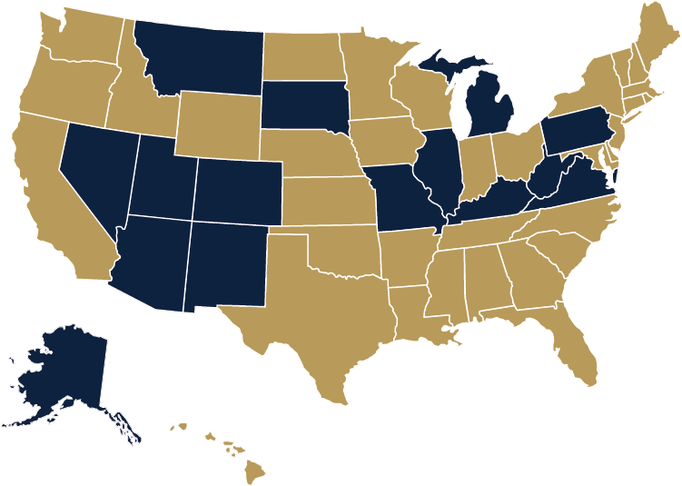
Mining Schools in Nevada
Great Basin College, Elko
University of Nevada, Reno
Source: Applied Analysis

Slide 13
Careers in Mining
Management level roles
Information Technology
Legal counsel
Government Relations
Database Technicians
Assay Lab Technicians
Accounts Payable/Receivable Admin
Electrical Engineer
Metallurgical Lab Technicians
Phone Technicians
Equipment Operators
Trainers
Payroll Administration
Tire Technician
Assay Lab Technicians
Controller
Equipment Trainers
Electrical/Instrumentation
Short & Long-Range Planners
Mining Engineer
Draftsperson
Communications
Industrial Hygiene
Technicians
Accountant
Modeling Engineer
Welder
Compensation
Mineralogical Engineer
Mechanical Engineer
MSHA Trainers
Geological Engineer
Benefits Administration
Chemical Engineer
Reliability Engineer
Occupational Health & Safety
Mine Geologist
Maintenance Planner
Employee Relations
Security
Operators
Blasting Engineer
Recruiting
Diesel Technician
Human Resources
Control Room Operators
Blasters
Surveyor
Environmental Engineer
Warehouse Technician
Metallurgical Engineer
Exploration Geologist
Risk management / Loss Control
Drillers
Dispatch Operator
Community Relations
Administration
Buyer
Inventory Control
IT Support Specialists Mine-Software Support Specialists
Contracts Specialist
Reclamation
Hydrological Engineer
Field Technician
Administrative Assistants
Supervisors

Slide 14
Careers in Mining – It’s Not Just Dirt
ADMINISTRATION
Purchasing/Materials Management
Buyer
Contracts Specialist
Inventory Control
Warehouse Technician
Human Resources
Recruiting
Employee Relations
Benefits Administration
Compensation
Accounting
Accountant
Controller
Payroll Administration
Accounts Payable/Receivable Admin
Legal counsel
Lean/Six Sigma/Continuous Improvement
Information Technology
Database Technicians
IT Support Specialists
Mine-software Support Specialists
Phone Technicians
SAFETY
Industrial Hygiene
MSHA Trainers
Occupational Health & Safety
Security
Risk management / Loss Control
ENVIRONMENTAL
Environmental Engineer
Hydrological Engineer
Field Technician
Reclamation
CORPORATE SOCIAL RESPONSIBILITY
Community Relations
Communications
Government Relations
POSITIONS FOUND IN ALL FUNCTIONAL AREAS
Management level roles
Administrative Assistants
Supervisor
Source: Applied Analysis

Slide 15
Safety First
Nevada Mining in 2019:
227 Active Mines
28.5 million work hours
179 with no reportable injury
89% better than national rate
Notes:
People who know that mining exist believe that mining is Nevada’s second largest industry, that is simply not true.

Slide 16
An Essential Nevada Industry

Slide 17
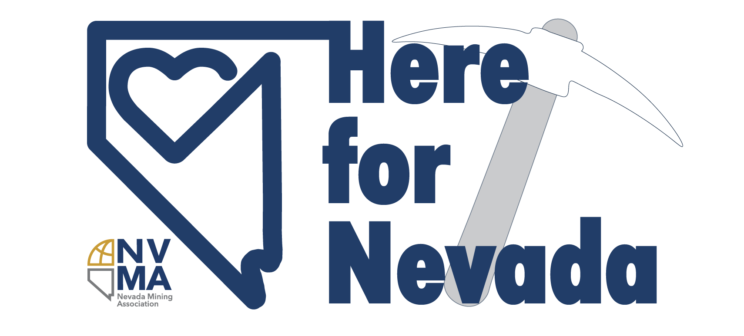
COVID-19 Response
Notes:
People who know that mining exist believe that mining is Nevada’s second largest industry, that is simply not true.

Slide 18
COVID-19 Response
Donations of PPE, school supplies, and setting up COVID testing sites
Mining Industry was the largest contributor to Nevada COVID Taskforce
Mining funded programs like the I-80 Fund and Storefront Business Benefit providing grants and loans to small businesses
NVMA hosted virtual food drive with Food Bank of Northern Nevada resulting in over 22,000 meals for Nevadans in need
Source: Applied Analysis

Slide 19
Sustainable Mining
Mining works closely w/fed, state, and local regulators to create robust environmental stewardship program
Mines submit reclamation plan and pay a bond before operations begin
State of NV holds $2.3 billion in bonds
Mines monitor air & water quality to ensure compliance. Also are regularly subject to regulatory inspections.
Mines fund projects to clean up mistakes of the past and also monitor modern projects even after released from governmental obligations
Source: Applied Analysis

Slide 20
Government Agencies with Mining Oversight
U.S. BLM
U.S. Forest Service
U.S. Mine Safety & Health Administration
Nevada Department of Conservation & Natural Resources
Division of Environmental Protection
Division of Water Resources
Nevada Department of Wildlife
Nevada Division of Minerals
Nevada Mine Safety and Training Section
Source: Applied Analysis

Slide 21
Nikki@NevadaMining.org
Notes:
People who know that mining exist believe that mining is Nevada’s second largest industry, that is simply not true.

